Slide 1
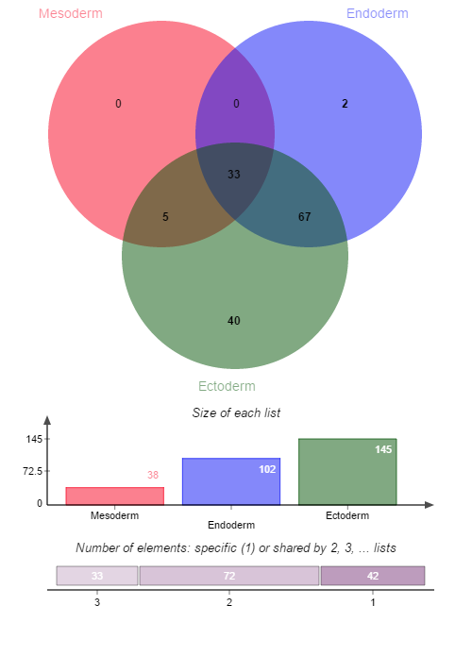
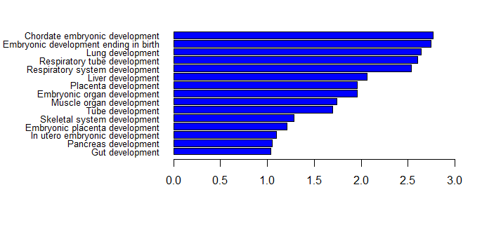
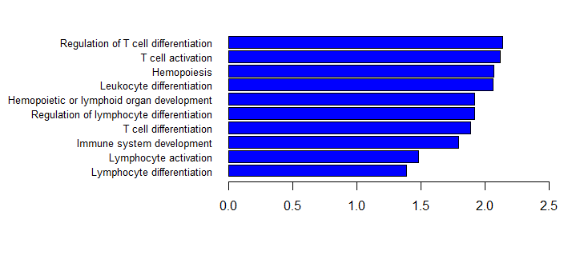
In the absence of Nanog, mouse embryonic stem cells differentiate into visceral/parietal endoderm.^{[1][2]}
Mesoderm and Endoderm shared hypo-MHL regions play the role to induce the development
ESRRA
NANOG
-log10(Benjamini P value)
Ectoderm specific hyper-MHL regions impress the immune system to
induce the ectoderm development
-log10(Benjamini P value)

